Slide 1




Weekly report: Load & Dynamics
Week number: 09
Date: 25/11/2025
Supervisor: Mr. Manjock
Group members: Md Aman, Arham Memon, Paresh Nakum
Presenter –Paresh Nakum
25/11/2025
Paresh Nakum
Optimus Syria

Slide 2
Agenda For Loads & Dynamics
Updated DLC 7.1
GitHub Updates
Conclusion & Future Plan
Bibliography
25/11/2025
Paresh Nakum
Load & Dynamics Team/ Optimus Syria

Slide 3
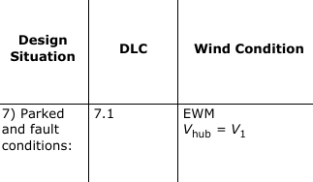
DLC 7.1 Parked plus fault conditions
Extreme Wind Model
1-year storm event with 34.0 m/s according to IEC class II-A
What does it Covers
Faults leading to a non-stand-by state (parked or idling) must be analyzed for consequences e.g. failure of pitch system, brake system or yaw system.
25/11/2025
3
Paresh Nakum
Load & Dynamics Team/ Optimus Syria

Slide 4
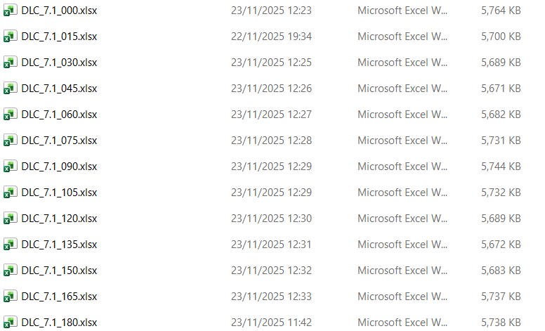
DLC 7.1 with yaw system failure
Conditions
The fault condition shall be combined with the extreme wind speed model (EWM) with a recurrence period of one year. A total of 12 cases in idling mode and with 15 degree angle wind direction difference have been analyzed (0 - 180 degree wind direction variation).
25/11/2025
4
Paresh Nakum
Load & Dynamics Team/ Optimus Syria

Slide 5
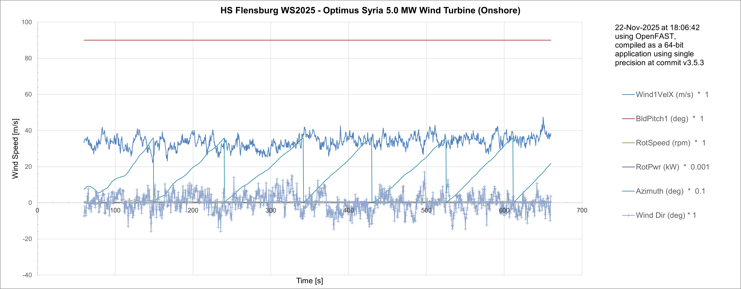
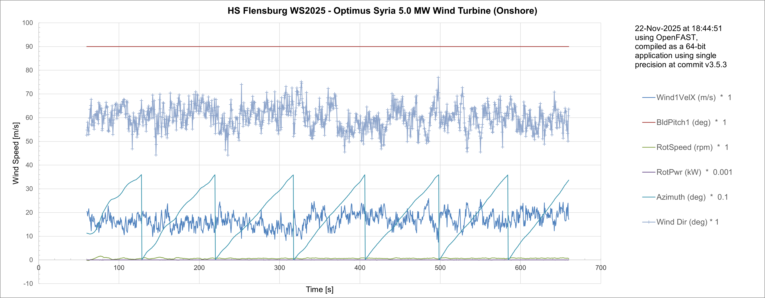
DLC 7.1 Simulation Result
Wind direction
0 Deg
Wind direction
60 Deg
25/11/2025
5
Paresh Nakum
Load & Dynamics Team/ Optimus Syria

Slide 6
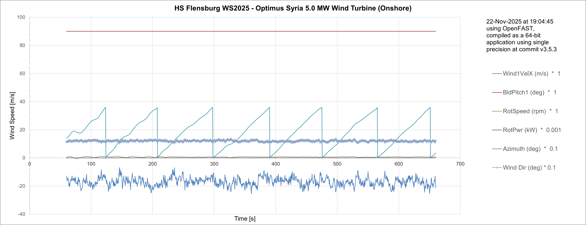
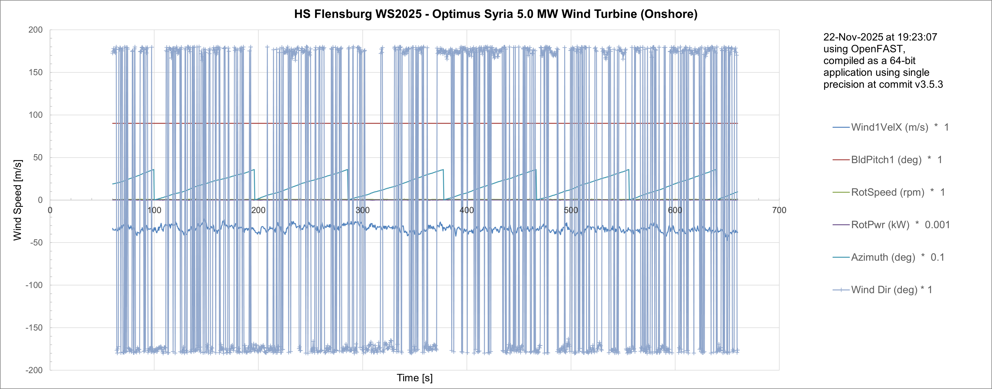
DLC 7.1 Simulation Result
Wind direction
120 Deg
Wind direction
180 Deg
25/11/2025
6
Paresh Nakum
Load & Dynamics Team/ Optimus Syria

Slide 7
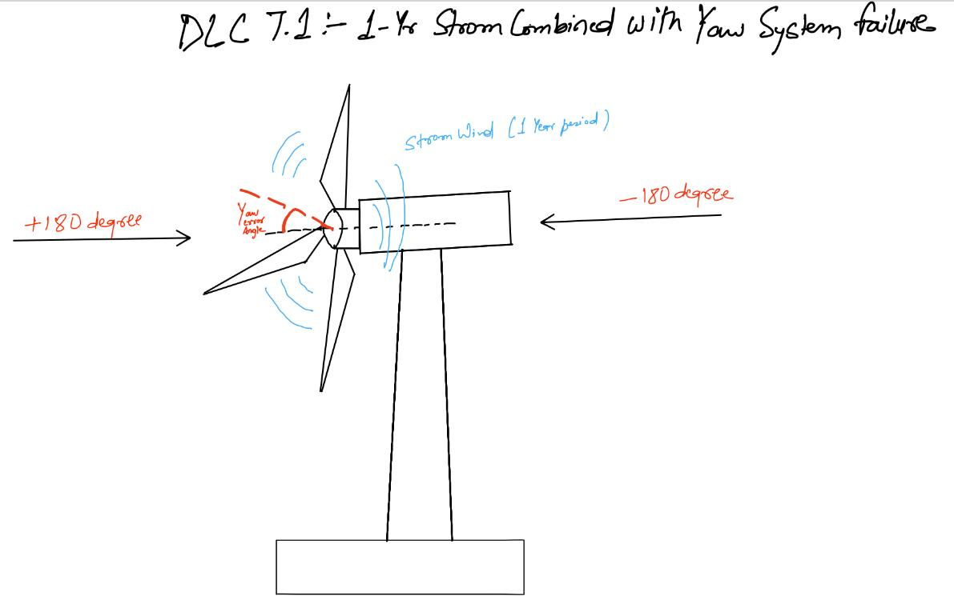
DLC 7.1 Sketch Wind Direction Variation
During a 1-year storm with a yaw system failure, where strong winds hit from both sides, creating a dangerous misalignment angle."
Then
What
Next
When a yaw error angle becomes large during a storm, the turbine faces sideways into the wind which we can see in the image. Protection systems pitch the blades, apply yaw brakes, and shut the turbine down to avoid dangerous side-loads.
Own hand sketchs
25/11/2025
7
Paresh Nakum
Load & Dynamics Team/ Optimus Syria

Slide 8
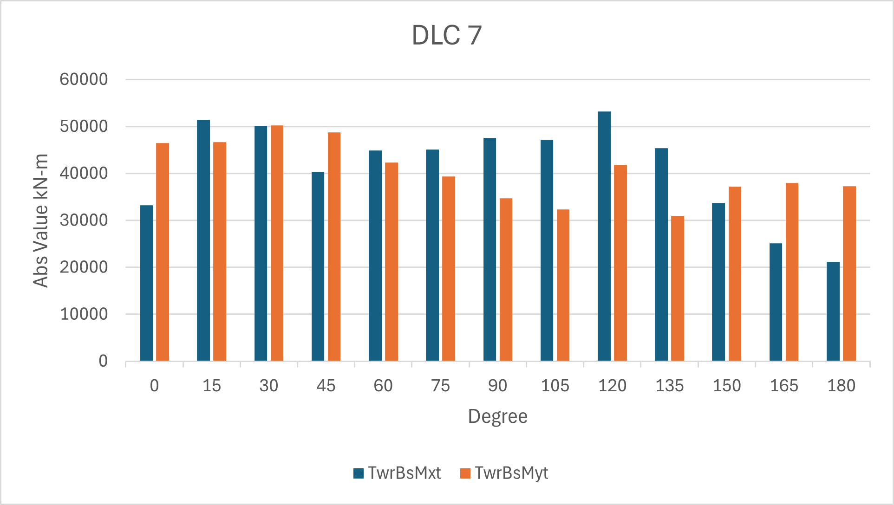
DLC 7.1 Tower Base Bending Moment
.1
Max tower bending at 120 Deg Wind Direction
Wind Direction in
We use the absolute maximum of TwrBsMxt and TwrBsMyt because the circular tower is structurally symmetrical. The magnitude of the moment is what dictates the maximum stress, regardless of the bending direction.
25/11/2025
Paresh Nakum
Load & Dynamics Team/ Optimus Syria

Slide 9
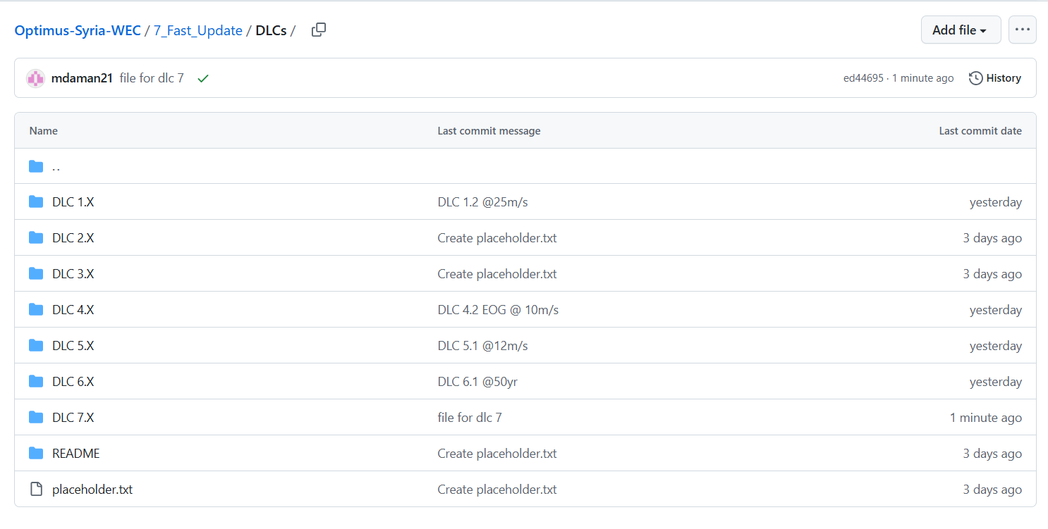
GitHub Update
In the Fast Update folder on Github Optimus Syria project a separate DLC folder is available with the present OpenFAST structure file, control file, Input file.
25/11/2025
9
Paresh Nakum
Load & Dynamics Team/ Optimus Syria

Slide 10
Conclusion & Future Plan
In the last week we
Configured Wind Simulations for DLC 7.1
Updated previous DLC Simulations
Provided forces and moments at different section of turbine to other teams
In the next week
Work with different groups for generating aero.dat, twr.dat files
Update the version of OpenFAST
Start Calculation of MExtremes
25/11/2025
10
Paresh Nakum
Load & Dynamics Team/ Optimus Syria

Slide 11
References
Load Reports of the OPTIMUS projects
GL Guideline for the Certification of Wind Turbines Edition 2010
Standard, DNVGL-ST-0376 – Edition December 2015
IEC 61400-1 2019-02, Ed. 4.0/ DNVGL-ST-0437 Loads and site conditions for wind turbines 11-2016
TurbSim, OpenFAST & NREL 5 MW
25/11/2025
11
Paresh Nakum
Load & Dynamics Team/ Optimus Syria

